Slide 1
You Too Can YouTube
2.0
Joined Extension in 2015
B.S. Texas A&M University in Ag Leadership
Currently working on my Masters in Instructional Design and Technology
I am not a pro YouTube creator
Subscribe to my YouTube Channel - BrazoriaFCH AgriLife
Cameron Peters
Family & Community Health Agent
Brazoria County

Slide 2
Why I
Went Online
Time
Expansion of the LGEG program
Future
Notes:
I didn’t have time to train the volunteers as often as I wanted to. I honestly was not preparing them like I should have been. I didn’t like feeling this way so I brainstormed ideas on how to streamline the process.
The Learn, Grow, Eat, and Go program got too big for me to teach and manage by myself. I had to learn to let go and manage the growth and let the volunteers teach. Doing this did not allow me to be there in the classroom for the volunteers to shadow me as I taught the first lesson. I had to come up with a way for the volunteers to see the lessons in action without me being there. I decided to record me teaching the videos so they could get my insights on how I teach the lessons and then they could go teach the lessons. This also worked well as a refresher for when we took a break over the summer.
As we see now with COVID-19 we see that we need to educate online and we can also reach a different audience than our typical face to face programs can.

Slide 3
10 Tips for Successful Videos
Plan your Content
Have the Right Equipment
Look for Inspiration
Make Every Second Count
Start with Simple Editing Software
Optimize your Videos
Build Your Network
Connect with your Viewers
Ignore ALL Negative Comments
Upload Videos Regularly
Notes:
Alright so I’m going to go over these top 10 tips in detail and how they can relate to our programming via YouTube.

Slide 4
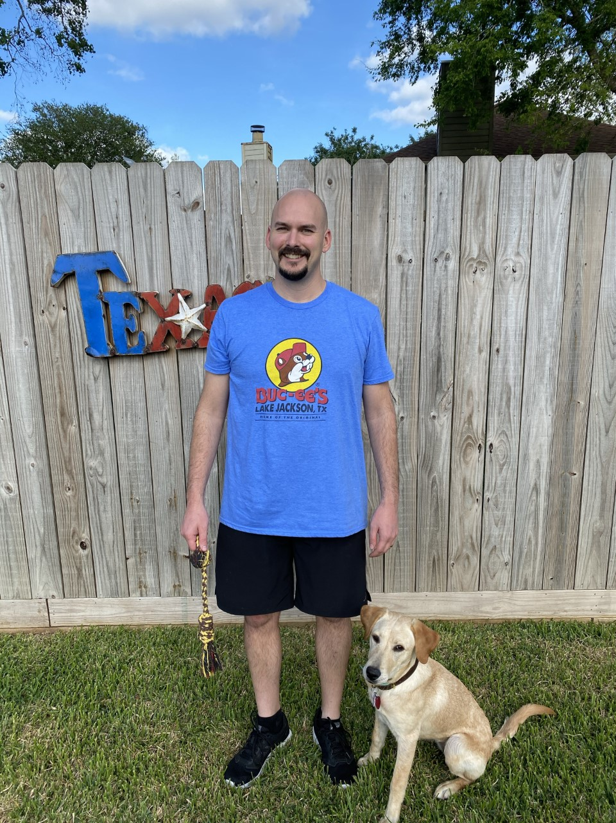
Meet James
James is an avid YouTube watcher when he has spare time. He likes to watch car shows, (people that go out and buy wrecked cars for cheap and fix them up). James wants to do this but James does not have the space nor the time. So he watches others do what he would rather be doing than being an accountant.
Notes:
You’ll hear me reference my husband, his name is James. He gives me ideas for how to enhance my YouTube channel. Meet James.

Slide 5
10 Tips for Successful Videos
Plan your Content
Have the Right Equipment
Notes:
Know what you are going to speak about. Write out a script or outline. This will help you think through the steps of your video. What is your goal for the video? Will you be using various locations? If so what will your transition look like? Costume changes? Etc. James made me watch this one guy, he sells shirts along with his car YouTube channel. The guy was wearing one shirt that he sells and then hit his chest with his hand, and the next thing you know, he’s wearing a different shirt that he sells. It was a really cool transition that grabbed my attention! Think of things similar to that to incorporate into your videos. So this morning I tried it for myself. Let’s take a look...
Show clip of transition example.
Have the right equipment. This is where the iPad video kit Treye Rice comes in handy. You can also use a GoPro but make sure you have a tripod to steady your camera. I would suggest the Top 3 things to purchase are: a Recording Device, tripod, and microphone. If outside may need to do a voice over later wind distracting loses focu. Everything else can come at a later date. Know how to work your equipment, don’t pull it out of the box the day you plan to record, there might be some trial and error things to work past. The next slide is a snapshot of the AgriLIfe Employee website that is on how to make quick videos, use it.

Slide 6
10 Tips for Successful Videos
Notes:
Show clip

Slide 7
10 Tips for Successful Videos
Plan your Content
Have the Right Equipment
Notes:
Know what you are going to speak about. Write out a script or outline. This will help you think through the steps of your video. What is your goal for the video? Will you be using various locations? If so what will your transition look like? Costume changes? Etc. James made me watch this one guy, he sells shirts along with his car YouTube channel. The guy was wearing one shirt that he sells and then hit his chest with his hand, and the next thing you know, he’s wearing a different shirt that he sells. It was a really cool transition that grabbed my attention! Think of things similar to that to incorporate into your videos
Show clip of transition example.
Have the right equipment. This is where the iPad video kit Treye Rice comes in handy. You can also use a GoPro but make sure you have a tripod to steady your camera. I would suggest the Top 3 things to purchase are: a Recording Device, tripod, and microphone. If outside may need to do a voice over later wind distracting loses focu. Everything else can come at a later date. Know how to work your equipment, don’t pull it out of the box the day you plan to record, there might be some trial and error things to work past. The next slide is a snapshot of the AgriLIfe Employee website that is on how to make quick videos, use it.

Slide 8
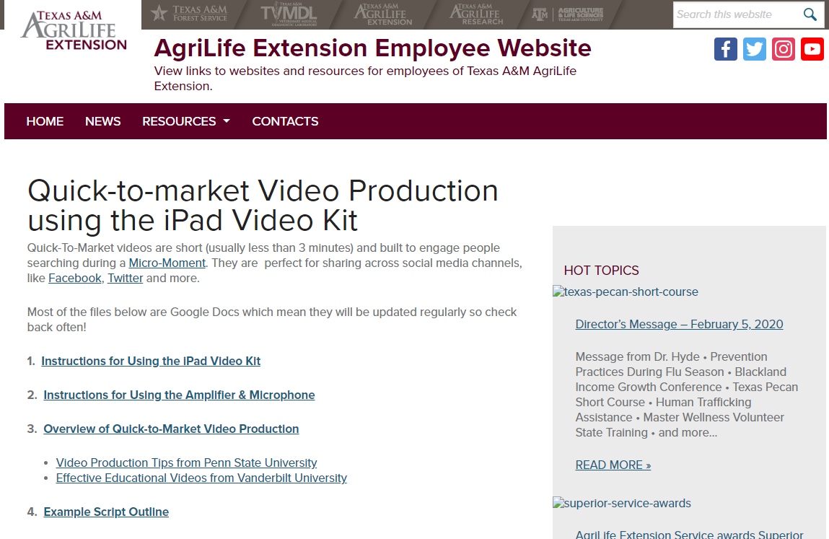

Slide 9
10 Tips for Successful Videos
3. Look for Inspiration
4. Make Every Second Count
Notes:
3. Check out other YouTube channels. See what works for them. What are they doing that makes you continue to watch them? Recipe videos that we see on Facebook, a ff version of a recipe is a great way to market a Dinner Tonight program, or start a how to graft a plant, and then when you’re about to get to the good part throw in your plug for your workshop coming up. As you think of an idea, write it down, put a note in your phone, and don’t let it get away from you. As you look at other channels for inspiration don’t get discouraged about your content. It takes time to build the ideal YouTube channel, trust me, I’m still working on mine. Make some notes not onluy about what you like or interests you ut what you dont’ like so you make you make sure you done fall into the trap.
4. Don’t have a lot of silence in your video, fill every second with sound or words. Be sure to edit out any dead time. People don’t have time to waste. I would not advise posting a video that is longer than 30 minutes, honestly 20 minutes or less is the best. Of course this depends on if you are entertaining or it is a commercial. Commercials should be a minute or less, honestly less. If you are providing edutainment then 5 - 20 minutes should be your goal. I produced a Handwashing video that I typically teach in the schools and it came out to be 26 minutes, looking back at it now I should have broken it into 5 different videos of about 5 minutes each, so I could produce more content for my viewers.

Slide 10
10 Tips for Successful Videos
5. Start with Simple Editing Software
6. Optimize your Videos
Notes:
5. Start simple. Try out different softwares until you find the one you like.Always start with free. But if you find one that looks interesting pay for one month to see if it’s worth it. But Look at blogs and read reviews. Later I’ll show you some options for software. Watch YouTube videos on how to use the software, or watch a video on what the best software is. EVERYTHING is on YouTube. I went to youtube to learn how to trim my blinds. Also be sure to use transitions in the software. Going along with your software. When you are recording, don’t be afraid to mess up. If you do, stop, breathe and count to 3, then start again. I say this because it makes editing much easier when you have space to work on the edit.
6. Optimize your video by giving it a catchy name and always be sure to add tags to your video. During the upload process YouTube will ask you to add tags. This will allow your video to show up in the search when someone googles that particular topic. You want to add as many relatable tags as possible so it has a higher chance of coming up in a search.

Slide 11
10 Tips for Successful Videos
7. Build Your Network
8. Connect with your Viewers
Notes:
7. Build your network. In the YouTube community they will bring other YouTube stars onto an episode of their channel. This encourages the watchers of YouTube star 1 to go watch YouTube Star 2’s channel so they can see their favorite person. In turn this will bring potential new subscribers to YouTube 2’s channel. It’s a give and take. Just like on FB, we want our partners to share our content if we share theirs. As I was preparing this, James told me how one of his channels, Cleetus McFarland is the guy, who is based in Florida and fixes up cars and trucks with his team and recently bought a race track and they have been telling their viewers about the progress of rebuilding the track, they talked about how much it would cost. Well they had a donor come in from their fan base and donate the labor and materials. The owner, Cleetus, just needed to pay for the cost of the concrete, and since they got a donation they were able to pour more concrete than planned. So yes that is on a larger scale, but think about what possible donations you could get if you built your channel up enough. Maybe it’s donations for a program, or donations to build a community garden, the possibilities are endless because you are reaching an audience outside of your normal range.
8. If you get really big you will have committed followers and they could ask for specific content. You might even get some fan mail. On one of James’ car channels, the followers would send Cleetus and his team, snacks via Amazon. People like them so much they send them free clothes, snacks, and products they want them to use in their garage. So if you get this far, be sure to mention those people who send you fan mail and then from that you will get more people sending things in because they will want to get mentioned. Part of this is also sharing your videos on Facebook, or at least a post guiding folks to your YouTube channel. These interactions are important because they help your subscribers learn more about you and it creates a community.

Slide 12
10 Tips for Successful Videos
9. Ignore ALL Negative Comments
10. Upload Videos Regularly
Notes:
9. No matter how big or small our channel might be there will always be negative comments. I haven’t gotten any yet, but I’m sure the more I produce, it will come. Just ignore them. Plain and simple. If it’s vulgar then delete or report it to YouTube.
10. Anybody listen to podcasts? I do, and when I get caught up on them I am excited for my channels to post more content. This is the same for YouTube. Even though you may be a novice at YouTube videos, it is better to continue to put your content out there rather than just once a month. I go through phases of uploading content, but I’m hoping that with this time that has been gifted to me I will be able to create more short videos to put on social media.

Slide 13
How I
Went Online
Studio
iPad Kit
YouTube
County Website
Notes:
LGEG recorded videos - I needed a place to store my LGEG videos and I thought I’ll create a YouTube channel and then link the videos to a MWV only webpage for them to view as needed.
I started by setting up the iPad kit and a backdrop that I had personally, you can buy them on Amazon for less than $50 and you can use twin flat sheets from Walmart as the backdrop. Or if you have a nice wall then you can use that.
Once I had my studio setup I pulled out the supplies I needed to record the lesson and got started.
Once the videos were complete I uploaded them to my YouTube Channel and from there we linked them to our MWV page on our county website. Feel free to go check out our Brazoria County FCH page, then click on the Master Wellness Volunteer section. When you scroll down you’ll see the option to go to another page. And from here you have to log in.

Slide 14
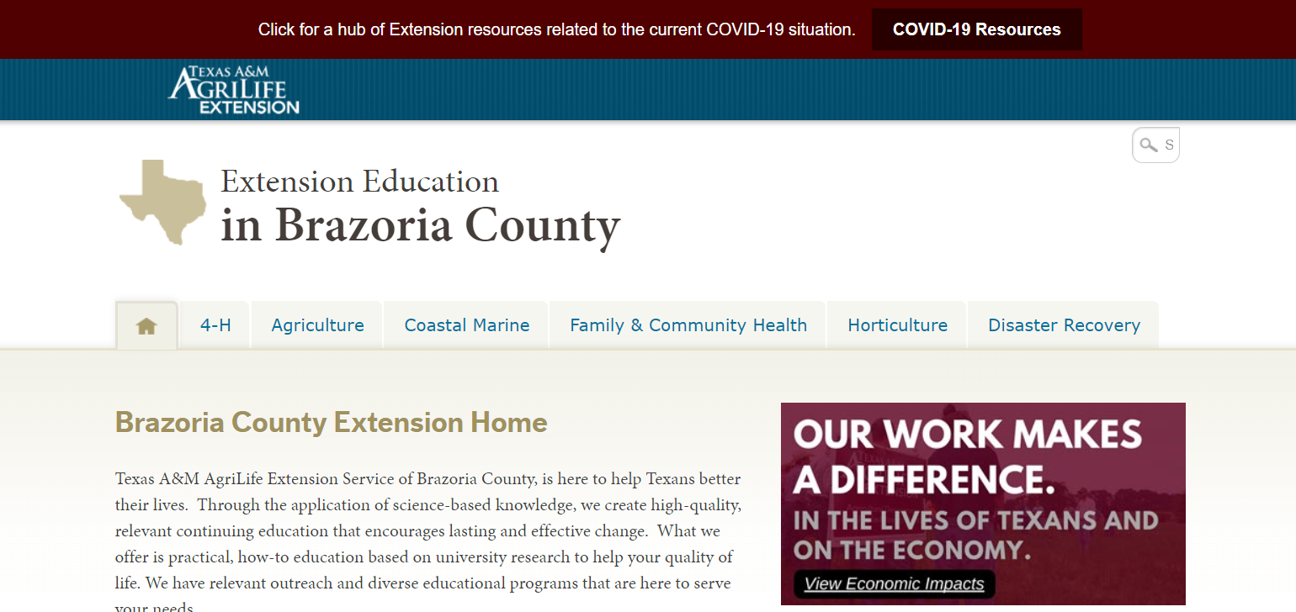
Uploading to County Website
Notes:
Go to our website and click on Family & Community Health

Slide 15
Uploading to County Website
Notes:
Click on the MWV tab

Slide 16
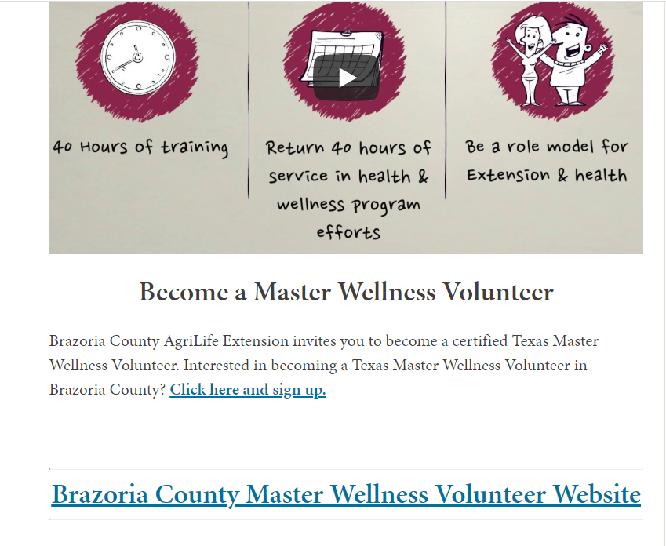
Uploading to County Website
Notes:
Scroll to the bottom, I have my MWV commercial on the website and at the bottom you’ll see the hyperlink to go to the mwv only page, click that.

Slide 17
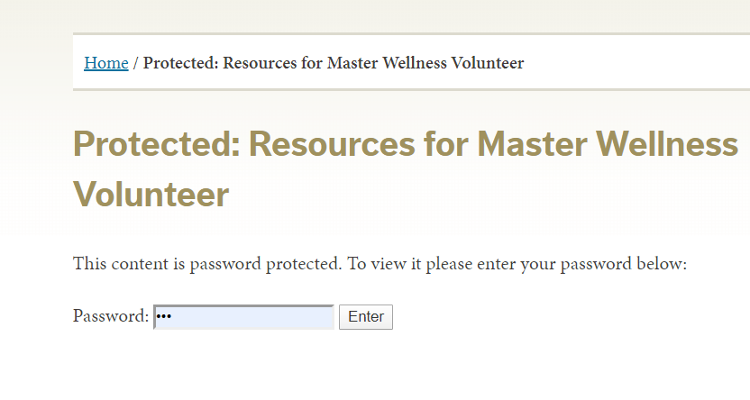
Uploading to County Website
Notes:
I don’t mind giving you the password, just please don’t share it with your volunteers or clients.
And it makes you enter the password, I kept it simple with “mwv” click enter

Slide 18
Uploading to County Website
Notes:
Click on the LGEG logo

Slide 19
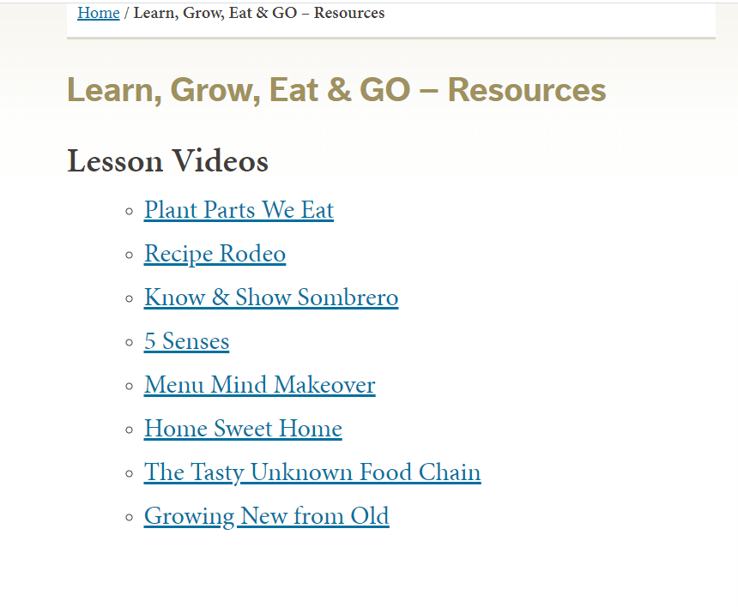
Uploading to County Website
Notes:
Now the MWV can find all of the videos that have been recorded so far, when they click on the link it directs them to the video on YouTube.

Slide 20
Commercials = Interpretation
Commercial/Video Computer Software
iMovie - Desktop
Movavi - Desktop
Camtasia - Desktop
Powtoon - cloud based
ClipChamp - cloud based
Biteable - cloud based
OFFEO - cloud based
Video Apps - Great for quick commercials
iMovie - free
Swish - free
Ripl
Animoto
Commercials I’ve made
Master Wellness Volunteers
Dinner Tonight
Brazoria County 4-H
Texas A&M AgriLife Extension - Brazoria County
Notes:
Here are the different types of software. iMovie is on the iPad, I would totally use this one if I had a Mac computer but since I have a PC I decided to use another type. Camtasia is one that we use to edit our LGEG videos, and it is almost free through Extension. John talked to someone at the district office and got us access to it. I purchased Movavi before I realized we had Camtasia, I like it but it is desktop based. For my handwashing video I used the free version of ClipChamp, I liked that this one is cloud based so I can use it on my work or personal computer. If you are good with an iPad then I would suggest using iMovie.
During one of my masters classes I needed to create a how to video and I found a software called Powtoon. There is a free version but I did the paid version that allows me 5 downloads within 30 days. I used one of my downloads for my school assignment then I used the other 4 for commercials for our office. In using Powtoon there are lots of templates I was able to use for inspiration to create my own commercials. This is a great software to make quick commercials. Go check out my channel to see the commercials.
So, Who doesn’t love to watch those short 30 second commercials on Facebook? Making and posting your own commercials is a great way to interpret your programs to your clientele and stakeholders. Whether you do this to bring them to your program or to show what the program was all about. If you do a wrap up commercial it can also be used to attract people to your next event. COLLECT VIDEO - client testimonials

Slide 21
Steps to logging in and uploading media
Notes:
I know it’s a little blurry but I wanted to make it large enough for yall to see. Alright so first you need to sign in or create an account.

Slide 22
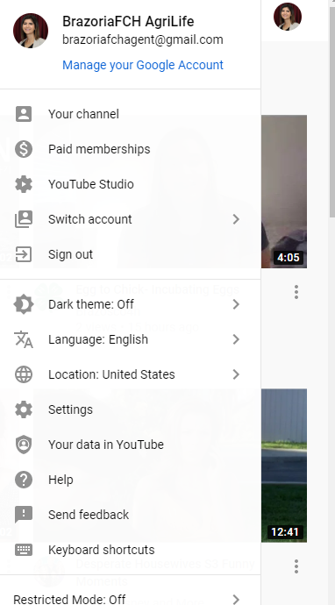
Steps to logging in and uploading media
Notes:
Once you have signed in when you click on your icon at the top you’ll get this drop down menu.
From here you can quickly access things that you might need in YouTube. This is how I quickly get to my channel.
If you have a personal YouTube you can also switch accounts here.

Slide 23
Steps to logging in and uploading media
Notes:
To upload a video you click the little camera with the plus sign on it

Slide 24
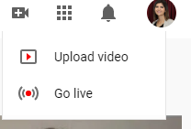
Steps to logging in and uploading media
Notes:
Click on it and it gives you two options. Upload video or Go Live. I have never gone live, only upload video.
Click on Upload Video

Slide 25
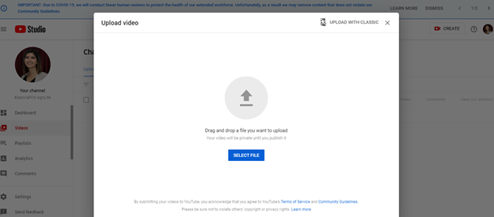
Steps to logging in and uploading media
Notes:
& it gives you this screen, Here you can drag and drop your files in or you can select the file by clicking on the blue button. Then find your file and it will upload it.

Slide 26
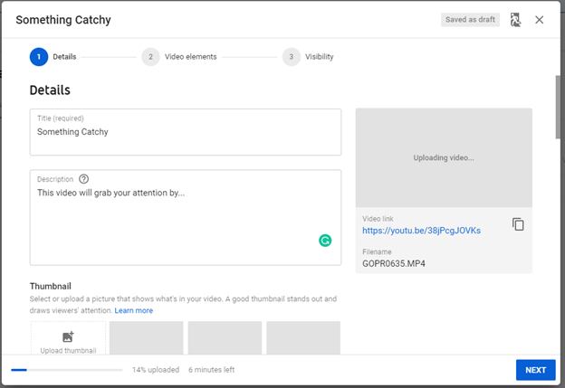
Steps to logging in and uploading media
Notes:
Give it a title
Be sure to add a description
Pick a good looking thumbnail. If you can’t find a thumbnail then I would create one in Canva, and Justin is doing a training on Canva tomorrow afternoon. YouTube will provide you with some options for a thumbnail. A thumbnail is what people see when they are searching for videos so you want it to look interesting. What I did with my handwashing video was play it on my computer and pause it and did a snip it of it and then I uploaded that snip it into YouTube where it says upload Thumbnail. That way I was able to choose what it looked like.
Click Next

Slide 27
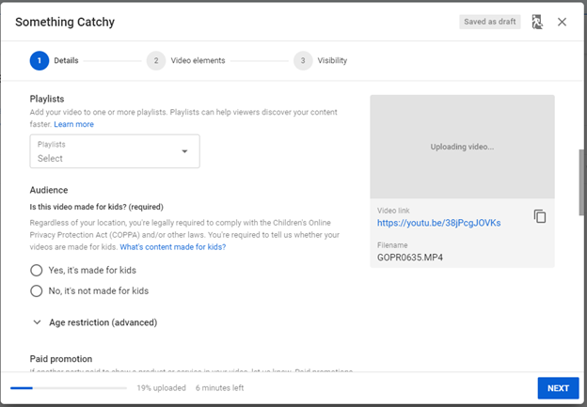
Steps to logging in and uploading media
Notes:
If you have a playlist you want your video to be assigned to this is where you can create and select a playlist. You can always go back and create a playlist later. I have a LGEG playlist so my volunteers can have all the videos in one folder per say
If your video is to edutain kiddos then you click yes it is made for kids and YouTube, once approved, will put it in the YouTube kids area
Click Next

Slide 28
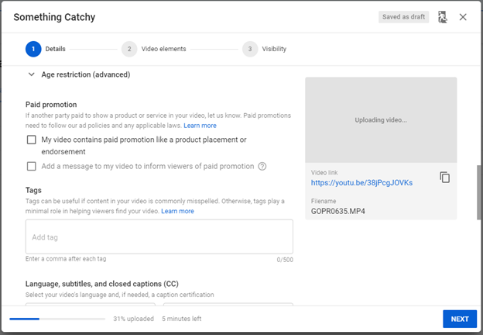
Steps to logging in and uploading media
Notes:
You’ll need to click on advanced and this is where you can access tags
You see where it says paid promotion? We don’t need to worry about that for us, that’s more advanced that what we need. If you get to that step where you have endorcements and you are getting paid to put products in your video then you’ll need to check that box.
Tags is where you will add words like, agriculture, soy bean, gardening, nutrition, etc.

Slide 29
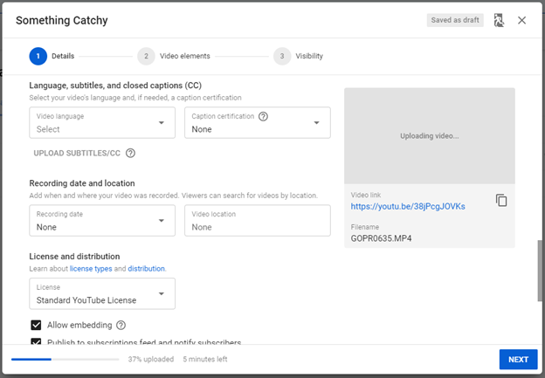
Steps to logging in and uploading media
Notes:
Language and subtitles you can turn these on, up to you, I would advise it for inclusion purposes
It is up to you if you want to put the recording date and location. I don’t think it would hurt to.
Click Next

Slide 30
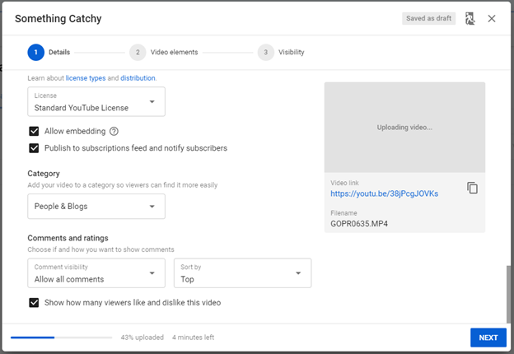
Steps to logging in and uploading media
Notes:
Then under License and distribution, I would keep the check for these, it will help to get your content out there and if someone wants to use your video it allows them to embed it.
Click on which category option best fits your video
Comments and ratings, I would keep all comments and allow likes and dislikes to be seen. This helps you know what your viewers like and will hopefully build that community.

Slide 31
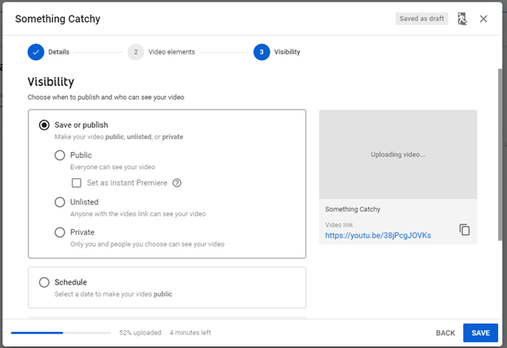
Steps to logging in and uploading media
Notes:
We skipped number 2, video elements because you can’t do that till your video is uploaded and it’s just about the ending. Nothing major.
So we are on step 3 of uploading.
Decide on your visibility option. I do Publish and Public, for this example I did private because it was raw footage. If you want to schedule your video to be posted at a certain time then you can totally do that, maybe you have all 5 videos ready but you want to publish one a week, this is where you do that.
Click Next

Slide 32
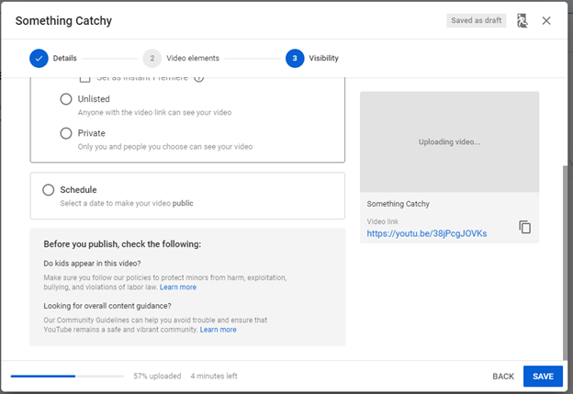
Steps to logging in and uploading media
Notes:
Be sure to read this section before you proceed.
Then click next

Slide 33
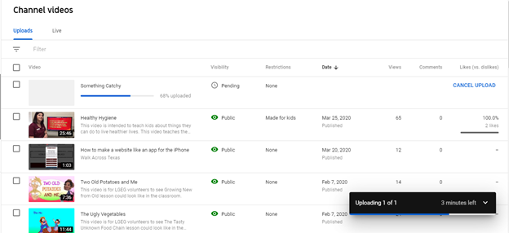
Steps to logging in and uploading media
Notes:
Once you click next, this screen will appear. You can see my video is in the process of being uploaded. If you realize you messed up you can click cancel upload and it will be deleted as well as your work of typing. So if you just want to add something to your tags, you can just wait for it to finish uploading. Once your video has uploaded it will be live on the web, if you selected for it to be public.
In this section you can see all of your videos in your channel. How many views likes and dislikes they have.

Slide 34
Advice
Branding, Branding, Branding
Your audience should be able to tell you are with Extension by looking at you
Don’t be afraid to mess up
Schedule time to make videos, don’t put it off
Look at what others are doing
Create a general email when setting up these type of accounts. Example: brazoriafchagent@gmail.com
Google or YouTube it or contact me if you have a question
Notes:
Branding, Branding, Branding: Where the logo & name tag & show the logo in the video.
Don’t be afraid to mess up, if you aren’t sure if it, get someone to watch your video before you upload it.
Schedule time to learn and actually do it. Time is hard to come by. I will say that for our LGEG videos I recorded them and then I had my admin edit them so we could get them to the volunteers faster.
Remember to look at others for inspiration. It takes time to truly get the hang of it, I’m still working on it and I’ve published a dozen videos.
This is something I would highly suggest. So I would suggest making a general gmail account to use for your social media. Mine is BrazoriaFCHagent@gmail.com My admin and myself have access to this account. This allows both of us to access our other accounts like Facebook, google sheets, YouTube, and any other log in that we have, we use this generic email. That way if something happens to me no one has to worry about getting all of the content I had and getting it transferred to them, All they have to do is contact FB to get the profile name changed from mine to theirs. Or if I get a new admin I just give them the generic log in so it is the same for all sites. I see that Brazos County and Montgomery County 4-H each have a channel, which is great that it a general name and not an agent in particular.

Slide 35
Questions?
Contact me
cameron.peters@ag.tamu.edu
Office 979-864-1199
Cell 979-319-1992
Check out my Google Site with other resources
https://sites.google.com/view/resourcesbycameron/home

